Slide 2
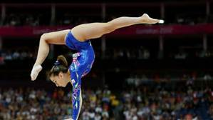
Gymnastics

Slide 3
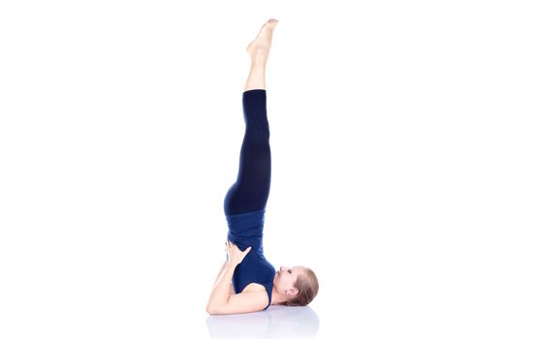
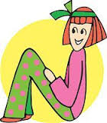
Solo Poses
Easy Moderate Hard
N Seat Knee Scale Candle Stick

Slide 4
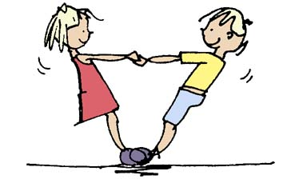
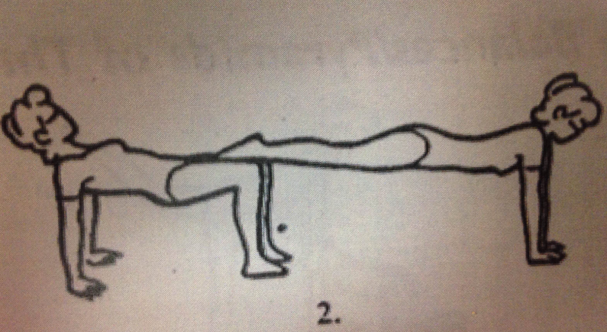
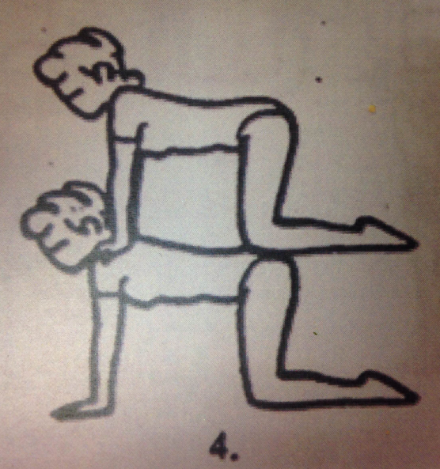
Double & Counter Balance
Easy Moderate Hard
Pressure on joints only:
Hips, Knees, Ankles & Shoulders
Careful not to kick if face

Slide 5
Pick 4
then
Choice or Create

Slide 6
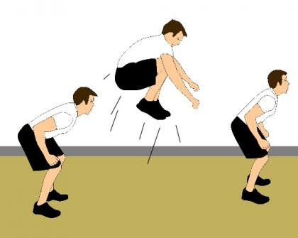
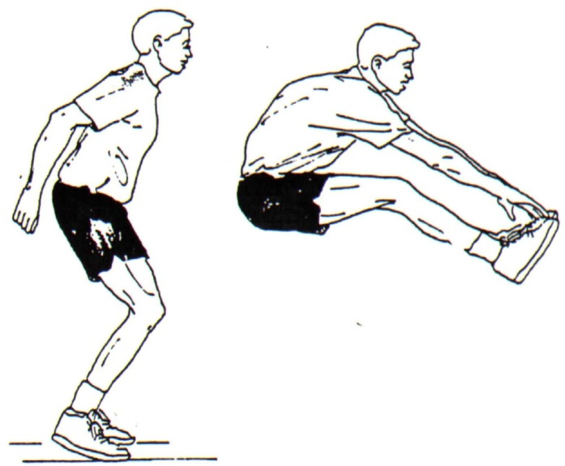
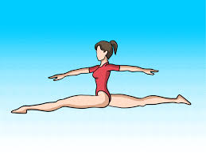
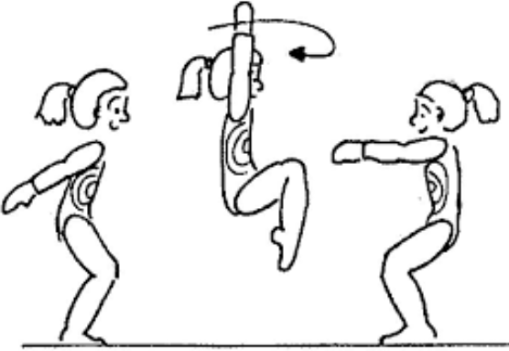
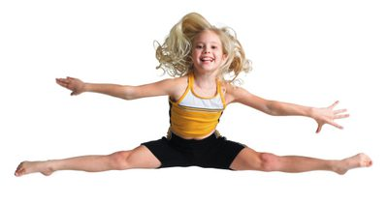
Jumps (Stick it) Pick 4
Star Tuck Pike
½ Turn & 360 Straddle Split

Slide 7
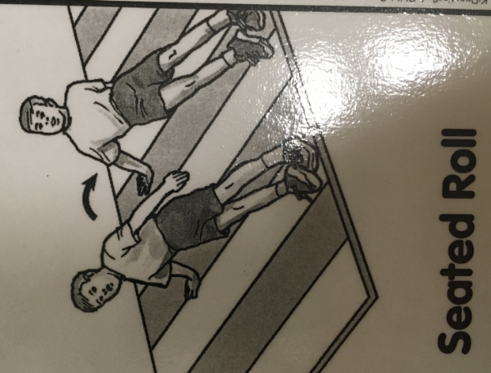
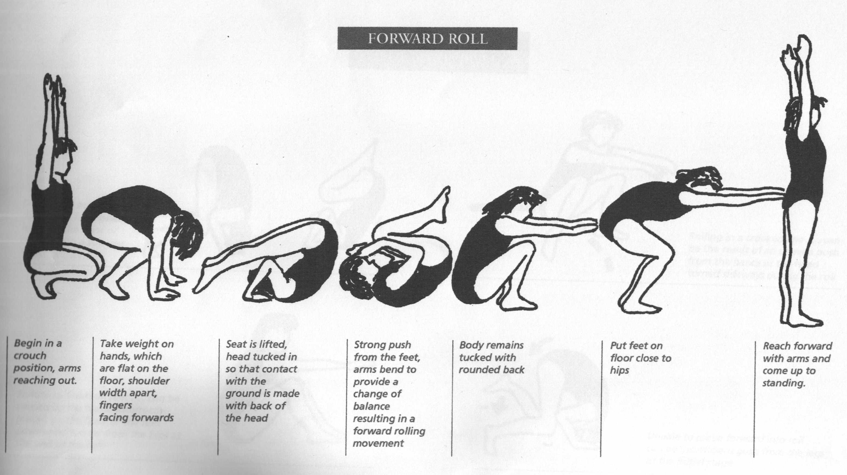
Rolls Pick 4
Forward Roll Cues:
Hands
Chin to Chest
Head Down & Push off Feet

Slide 8
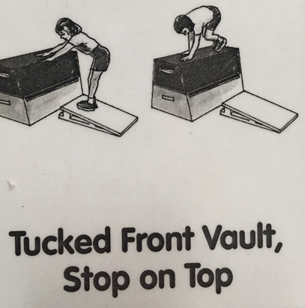
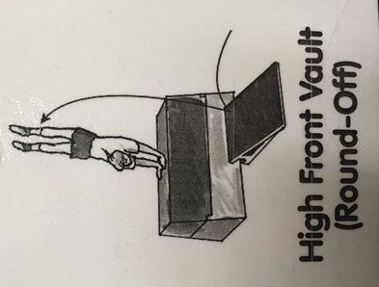
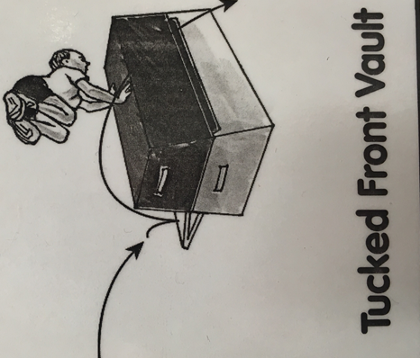
Vault Pick 4
Easy Moderate Hard
Work at your COMFORT LEVEL
No flips

Slide 10
Hand Stands (Lock your elbow)

Slide 11
Teacher Help Only Grades 3-6
Do you want to learn how to do a headstand?

Slide 14
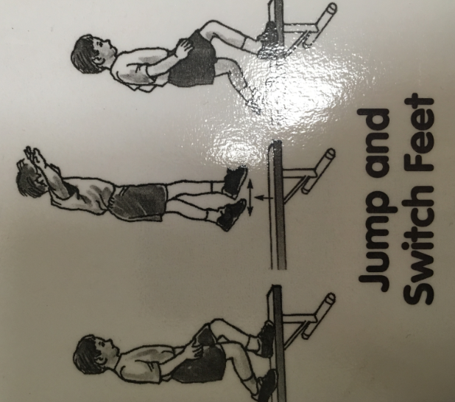
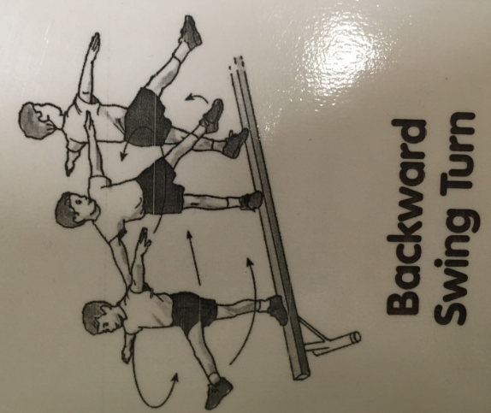
Beam Pick 4
Others include:
Forward/Backward Walk
Crawl
Grapevine
Pivot

Slide 15
Invent Your Own

